Slide 1
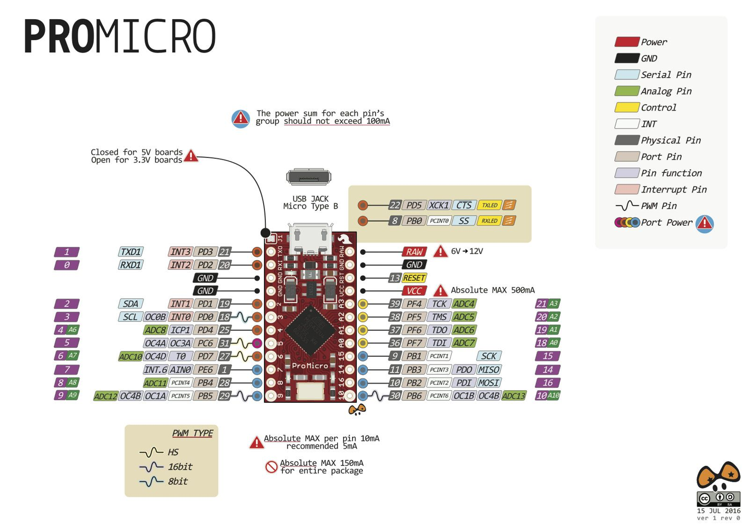
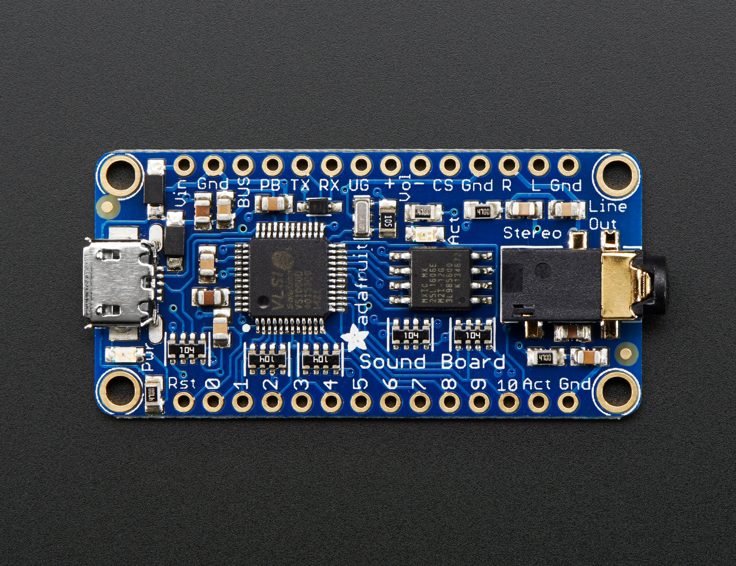
RX SFX
TX SFX
-
-
SCREEN ??
SCREEN ??
RESET SFX
FOOT SWITCH
LED RING
-
CAM FOCUS
CAM TRIGGER
-
-
-
-
STATUS LEDS
TIME BTN
START BTN
-
-
-
-
PWM OUT

Slide 2
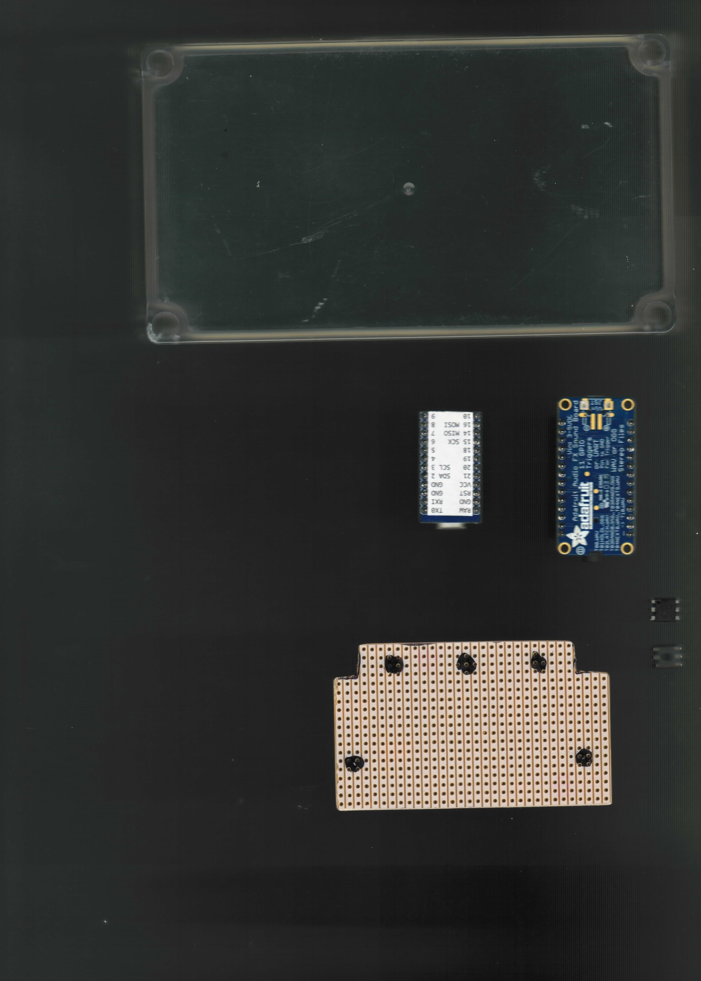
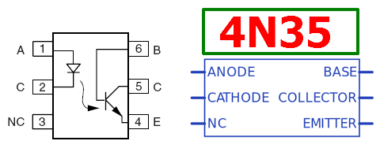
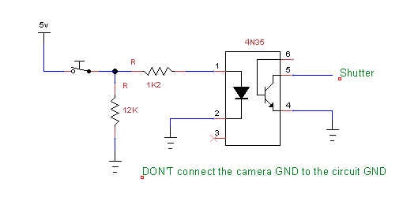
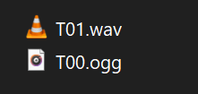
X
X
X
X
X
X
X
X
X
CAMERA
X
X
R
L
G
+
F
S
G
X
X
X
X
X
X
X X
AUDIO
X
X
X
LED RING
1K2
1K2
+
G
D
NC
X
X
X
X
X
X
X
X
X
X
X
X
X X X X
X
X
X
X
X
X
X
X
X
X
X
X
X
+
G
D
T
S
BOX BTNS & LEDS
X
X
X
X
X
X
X
X
X
CAMERA
X
X
R
L
G
+
F
S
G
X
X
X
X
X
X X
AUDIO
X
X
X
LED RING
X
1K2
1K2
+
G
D
NC
X
X
X
X
PRW IN
X
X
X
X
X
X
X
X
X X X X
X
X
X
X
X
X
X
X
X
X
X
X
X
X
X
10K
+
G
D
T
S
X
X
FOOT SW
1K2
PWM OUT
BOX BTNS & LEDS
S
+
G
S
NOTE: I don’t think the Arduino can power everything through it’s RAW pin so plug in an external 5V instead and put a diode in line with supply to the Arduino so that it doesn’t feed back power to everything else and blow its fuse

Slide 3
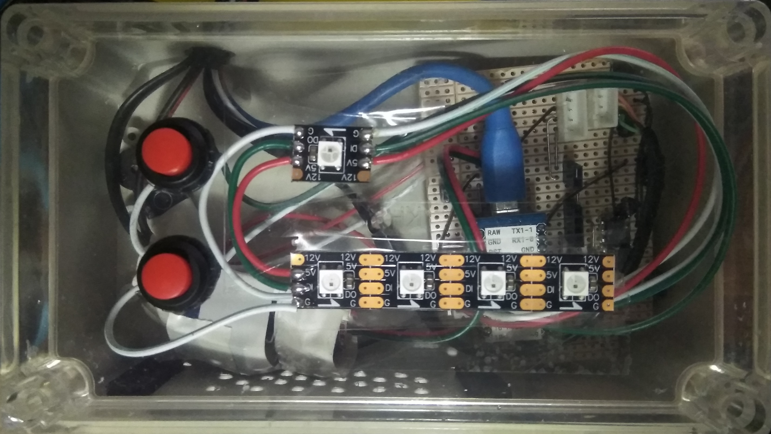
START
STOP
PHOTO LENGTH
15
30
45
60
SECONDS

